Slide 1


Slide 2
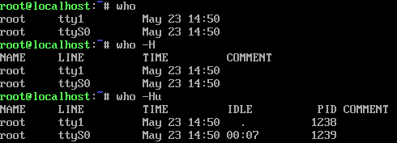
who
UNIX maintains an account of list of all users logged on to the system.
The who command displays an informative listing of these users.
Examples:
who command displaying an informative listing of users

Slide 3
who
UNIX maintains an account of list of all users logged on to the system.
The who command displays an informative listing of these users.
Examples:
who command with –H option displaying list of users along with header information

Slide 4
who
UNIX maintains an account of list of all users logged on to the system.
The who command displays an informative listing of these users.
Examples:
who command with –u option displaying detailed information of users

Slide 5
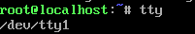
tty
tty is used to display the current terminal used by user.
UNIX treats terminals as files
Example:
tty command is displaying the terminal named tty1 which is under the /dev directory

Slide 6
stty
Different terminals have different characteristics. For instance, command interruption may not be possible with [ctrl+c] on your system.
Sometimes you may like to change the settings to match the ones used at your previous place of work.
UNIX treats terminals as files
Stty used for displaying and setting terminal characteristics.

Slide 7
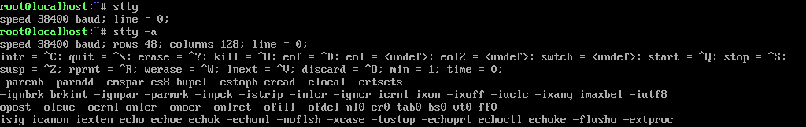
Example:
Stty command with –a option displaying current settings of the terminal.

Slide 8
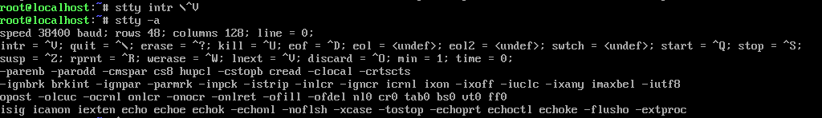
Example: Changing the interrup key (intr)
Changing the interrupt setting into [ctrl+v] using stty command along with intr \^V

Slide 9
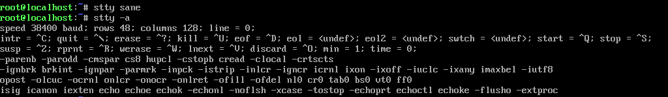
Example: Reset everything to default settings
stty command along with sane would set the terminal settings to default settings which would work on most terminals

Slide 10
Essential System Administration
The system administrator is also known as superuser or root user.
The job of system administration involves the management of the entire system ranging from maintaining user accounts, security and managing disk space to performing backups.
Root: The System Administrator's Login
The UNIX system provides a special login name for the exclusive use of the administrator; it is called root.
This account doesn’t need to be separately created but comes with every system. Its password is generally set at the time of installation of the system and must be used on logging in.

Slide 11
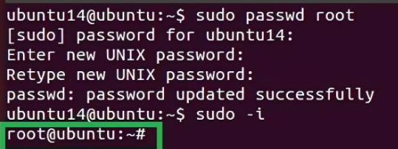
Becoming root user at login time
Once you login as a root, you are placed in root’s home directory. Depending on the system, this directory could be / or /root.
Administrative commands are resident in /sbin and /user/sbin in modern systems and in older system it resides in /etc.

Slide 12
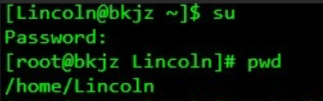
Becoming root user using su command
Any user can acquire superuser status with the su command if they know the root password. For example, the user Lincoln becomes a superuser in this way.
Though the current directory doesn’t change, the # prompt indicates that Lincoln now has powers of a superuser.

Slide 13
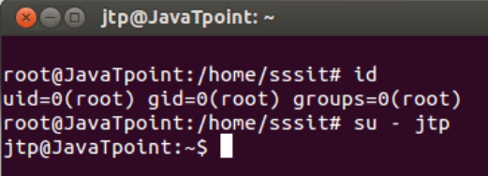
Creating a user’s environment
User’s often rush to the administrator with the complaint that a program has stopped running. The administrator first tries running it in a simulated environment.
su command when used with a – (minus), recreates the user’s environment without the login-password route.
This sequence executes jtp’s profile and temporarily creates jtp’s environment. su runs in a separate sub-shell, so this mode is terminated by hitting [ctrl+d] or using exit.

Slide 14
User management
Useradd, usermod, userdel.
Creating a group:
UID
GID
The home directory
The login shell
The mailbox in/ var/mail
The password

Slide 15
Group add
User will always carry One primary group and one or more supplementary groups.
Group files contains all of the named groups of the system
Structure:
root:x:0:root
bin:x:2:
lp:x:7
usp:x:18:a,b,c
class:x:1000:

Slide 16
Four colon-delimited fields
Group ownership
Group password
GID
Usernames
To create a new group: groupadd

Slide 17
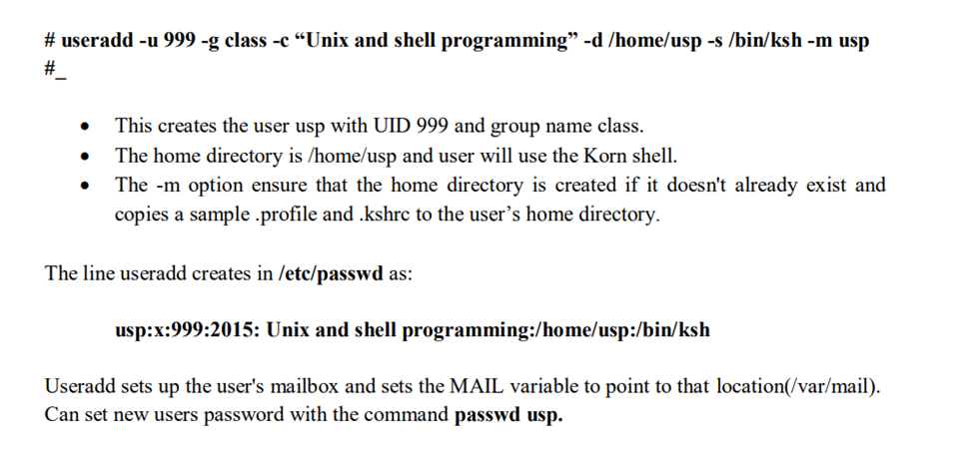
Useradd

Slide 18
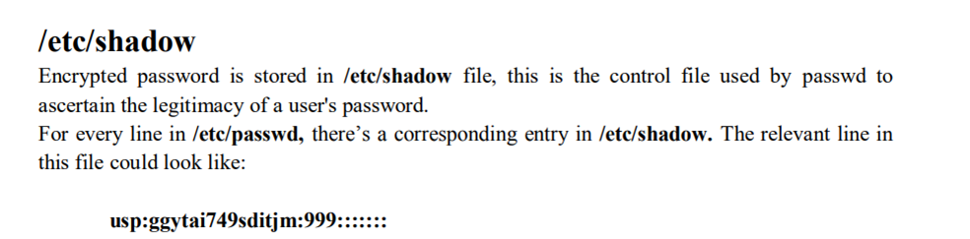

Slide 19
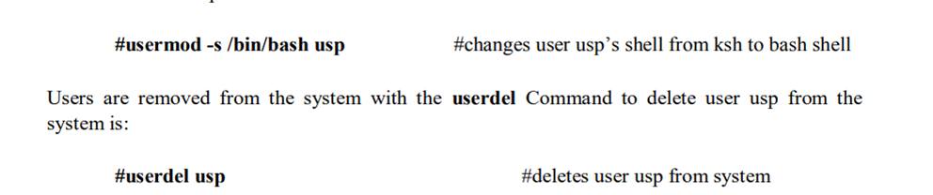
Usermod and Userdel: Modifying and removing Users

Slide 20
THE FILE
What is a file?
The basic definition of a file is that it is the container for storing information.
“But there are somethings about the file which are not stored in itself.”
A file’s name or size is not stored in file.
All file attributes such as file type, permissions, links, owner, group owner etc are kept in a separate area of the hard disk, not directly accessible to humans, but only to kernel.

Slide 21
Types of FILE
The UNIX has divided files into three categories:
Ordinary file – It is also called as regular file. It contains only data as a stream of characters. Ordinary files are itself divided into 2 types.
Text File – it contains only printable characters, and you can often view the contents and make sense out of them.
Example: Any notepad file is a text file.
Binary file – it contains both printable and unprintable characters that cover entire ASCII range. Examples- Most
Unix commands, executable files, pictures, sound and video files are binary.

Slide 22
Directory file – it is a file that only contains files and other sub-directories.
A directory contains no data but keeps some details of the files and subdirectories that it contains.
A directory file contains an entry for every file and subdirectories that it houses.
If you have 20 files in a directory, there will be 20 entries in the directory.
Each entry has two components-
The filename
A unique identification number for the file or directory (called as inode number).
Example : /usr/bin
Device file – all devices and peripherals are represented by files.
Installing software from CD-ROM, printing files and backing up data files to tape.
All of these activities are performed by reading or writing the file representing the device.
Advantage of device file is that some of the commands used to access an ordinary file also work with device file.
Device filenames are generally found in a single directory structure, /dev.

Slide 23
WHAT'S IN A (FILE) NAME?
Following are some features of a file name
A filename can consist up to 255 characters.
File may or may not have extensions, and consist of any ASCII character expect the / & NULL character.
Users are permitted to use control characters or other unprintable characters in a filename. Examples - .last_time list. @#$%*abcd a.b.c.d.e
But, it is recommended that only the following characters be used in filenames-
Alphabetic characters and numerals
The period(.), hyphen(-) and underscore(_).

Slide 24
THE PARENT-CHILD RELATIONSHIP
The file system in UNIX is a collection of all of these files (ordinary, directory and device files) organized in a hierarchical (an inverted tree) structure as shown in below figure.

Slide 25
The feature of UNIX file system is that there is a top, which serves as the reference point for all files.
This top is called root and is represented by a / (Front slash).
The root is actually a directory.
The root directory (/) has a number of subdirectories under it.
The subdirectories in turn have more subdirectories and other files under them.
Every file apart from root, must have a parent, and it should be possible to trace the ultimate parentage of a file to root.
In parent-child relationship, the parent is always a directory.

Slide 26
The HOME VARIABLE: HOME DIRECTORY
When you logon to the system, UNIX places you in a directory called home directory.
It is created by the system when the user account is created.
If a user login using the login name kumar, user will land up in a directory that could have the path name /home/kumar.
The shell variable HOME knows the home directory.
Command: $echo $HOME
Output: /home/kumar

Slide 27
pwd: CHECKING YOUR CURRENT DIRECTORY
The present working directory is the directory in which the user is currently working in.
Each time you interact with your command prompt, you are working within a directory.
By default, when you log into your Linux system, your current working directory is set to your home directory.
Any time user can know the current working directory using pwd command.
Command: $ pwd
Output: /home/kumar
Like HOME it displays the absolute path.

Slide 28
Changing The Current Directory
In UNIX file system, We can change the directory by using the command “cd”.
We can change the directory with or without arguments. When we want change the directory with arguments, we can specify the relative or absolute pathname.
Relative Absolute
$pwd $cd/home/sush/progs
/home/sush $pwd
$cd progs /home/sush/progs
$pwd
/home/sush/progs

Slide 29

Creating Directories
Directories are created with mkdir command. This command is followed by names of the directories to be created.
$mkdir patch
We can create several subdirectories like
$mkdir patch sush
$mkdir patch sush sush/dsush sush/sushruth
The above command creates 3 subdirectories – sush, dsush, sushruth
We can’t create the child subdirectories before crating parent directory

Slide 30

Removing Directories
Directories are removed with rmdir command. This command is followed by names of the directories to be removed.
$rmdir sush
rmdir except the arguments reverse of mkdir.
$rmdir sush sush/dsush sush/sushruth
In the above command the subdirectories are removed first and then parent directory is removed.

Slide 31
Absolute Pathname
A pathname is absolute, if it is described in relation to root.
Absolute Pathname always begin with a “/”.
Directories are arranged in a hierarchy with root at the top.
Example
Date command can be executed in 2 ways as,
$date
Thu Sep 22 12:00:00 IST 2022 --Relative Path
$/bin/date
Thu Sep 22 12:00:00 IST 2022 --Absolute Path

Slide 32
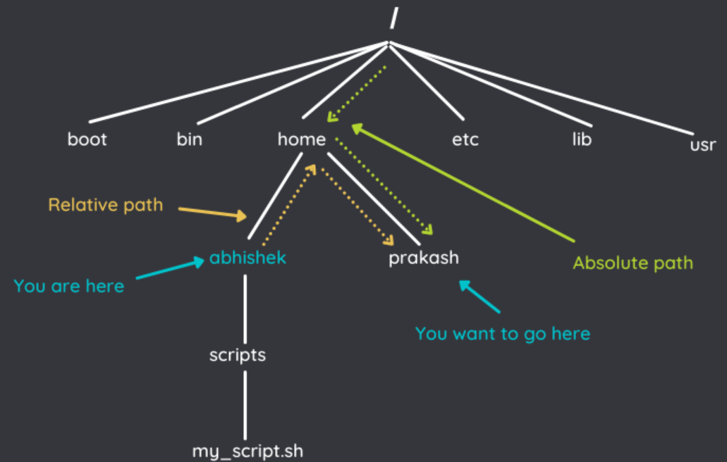
Relative Pathname
Relative Pathnames never begin with “/”.
A pathname can also be relative w.r.t. your current working directory.
We can use “.” and “..” to navigate. The single dot represents the current and double dot represents the parent directory.
$pwd
/home/sush/progs
cd..
$pwd
/home/sush

Slide 33
Thank
YOU

